Slide 1


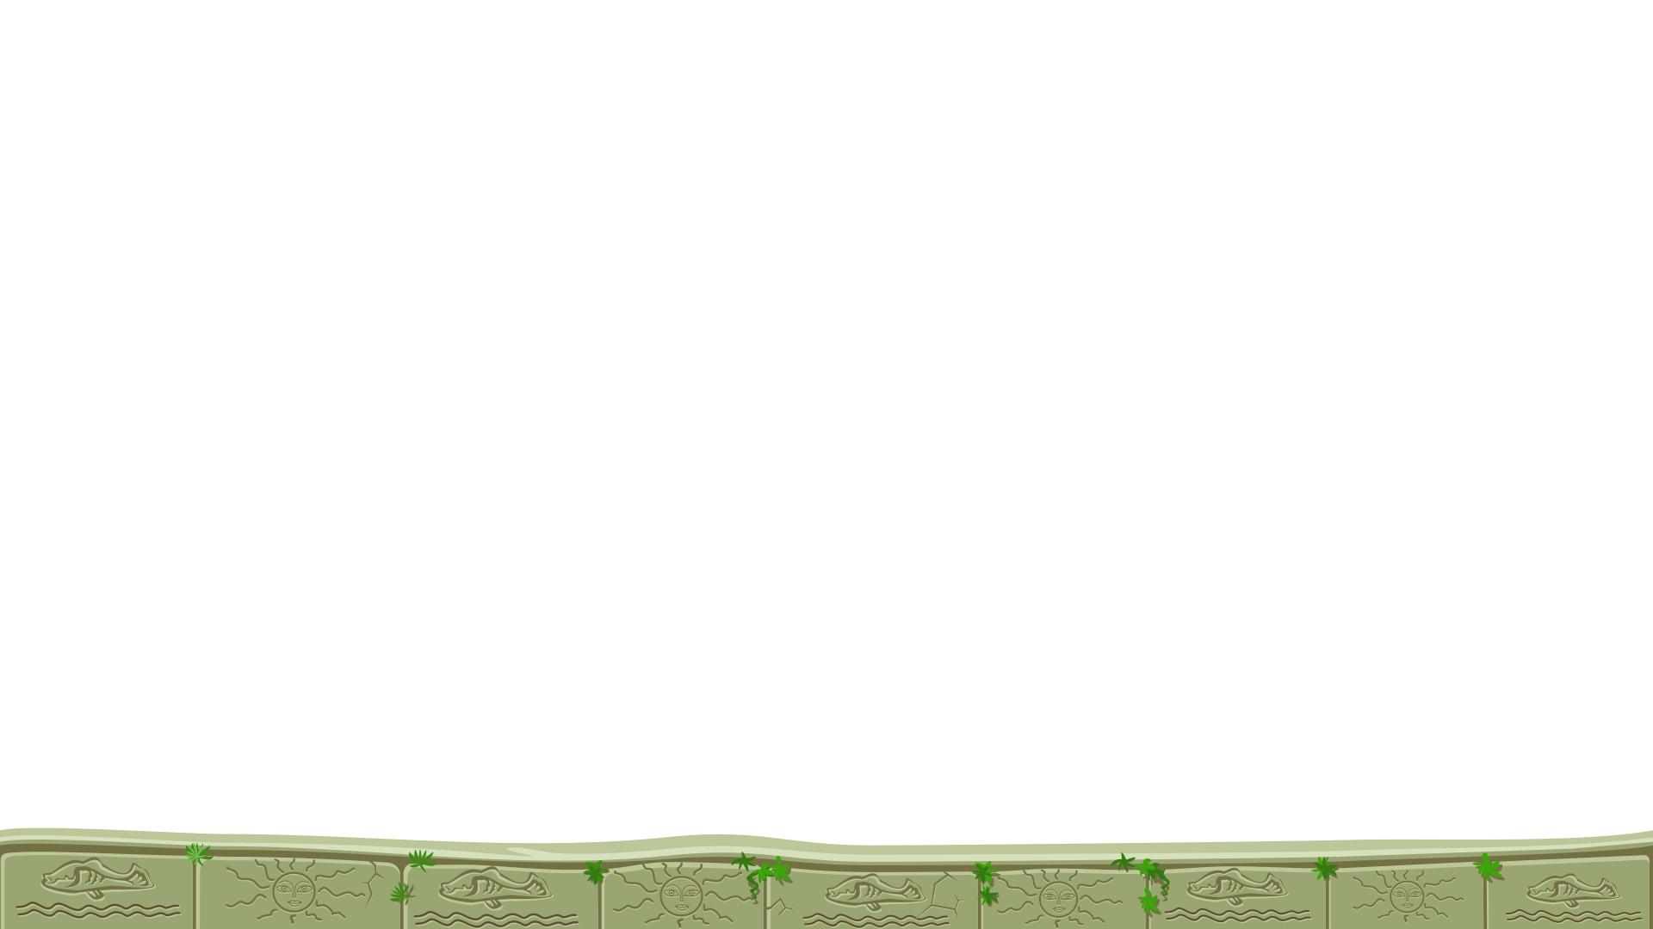

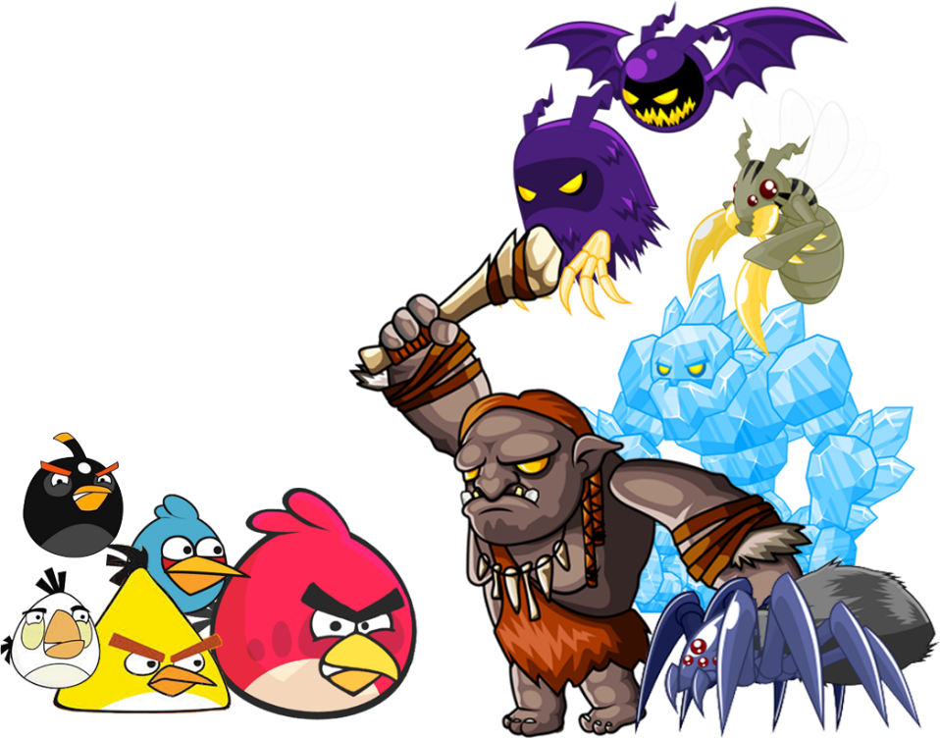




Angry bird new adventure

Slide 2

ANONYMOUS TEAM
Lê Ngọc Kiên
Đinh Trần Toản
Nguyễn Xuân Hiến

Slide 3

Introduce
Game idea
Casual game
Obstacles, enemies, weapons
Easy to play but a bit challenging
Another angry bird with different playstyle

Slide 4
Gameplay
Overview
Control
Enemies
Items
Environment

Slide 5
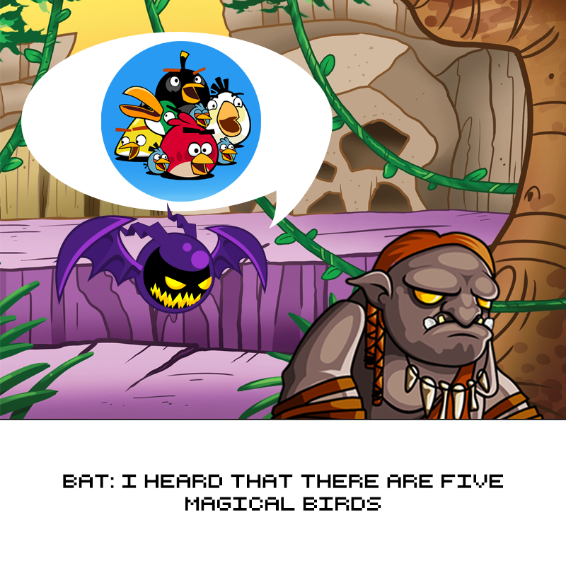
Gameplay
Overview

Slide 6
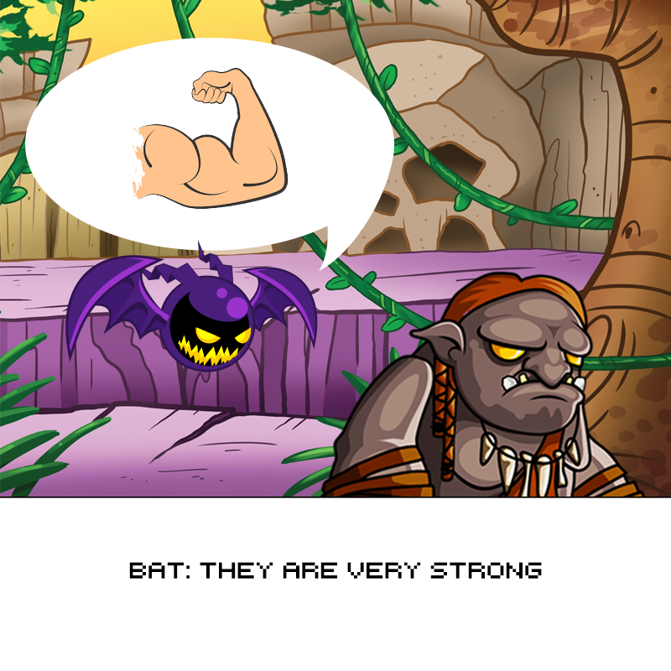
Gameplay
Overview

Slide 7
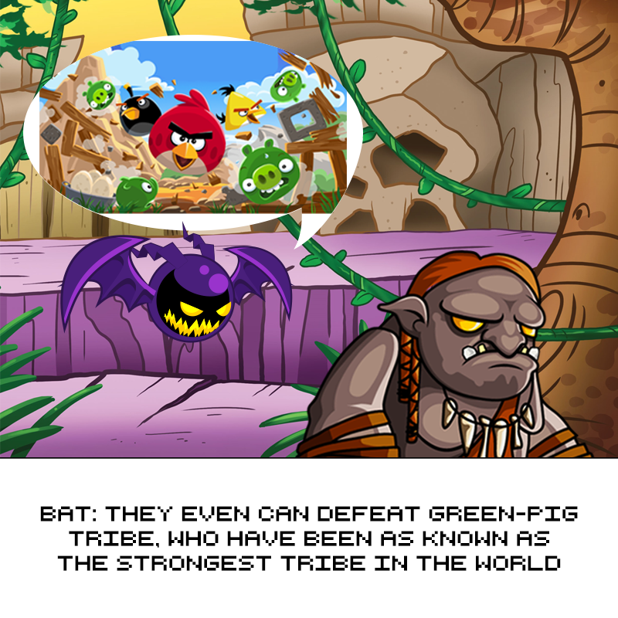
Gameplay
Overview

Slide 8
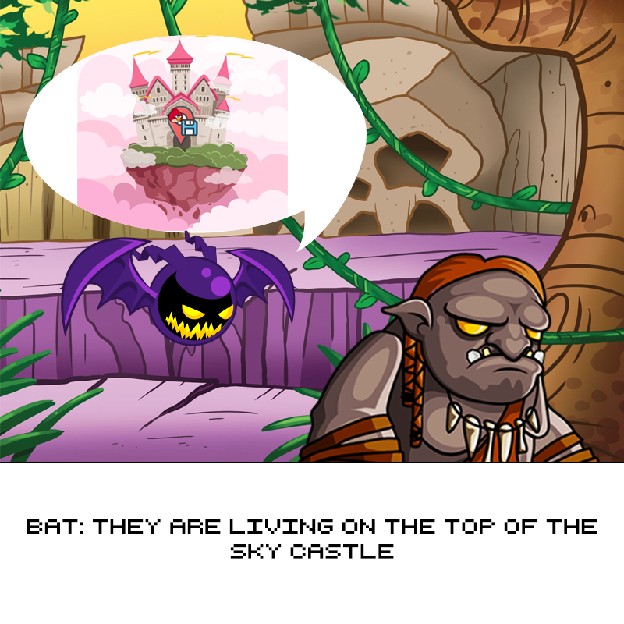
Gameplay
Overview

Slide 9
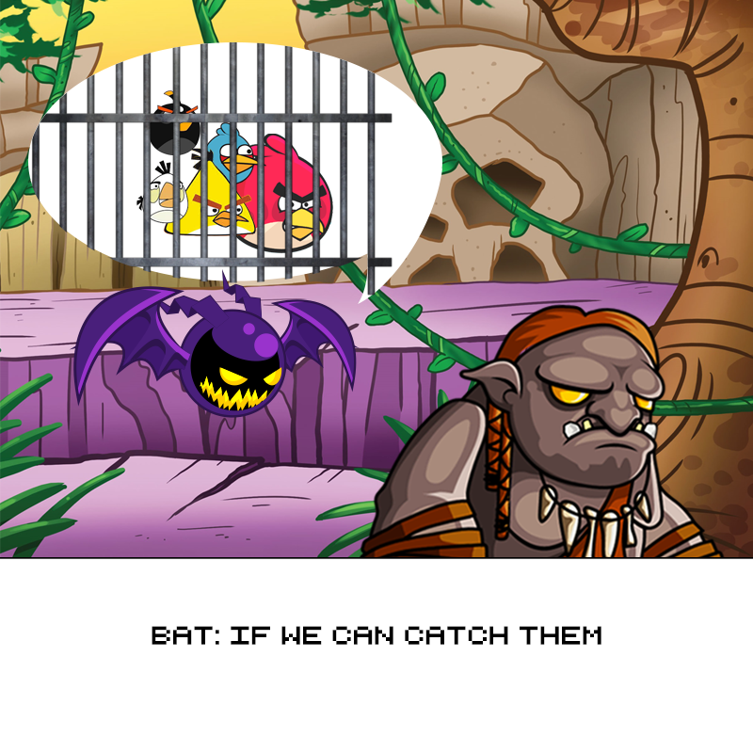
Gameplay
Overview

Slide 10
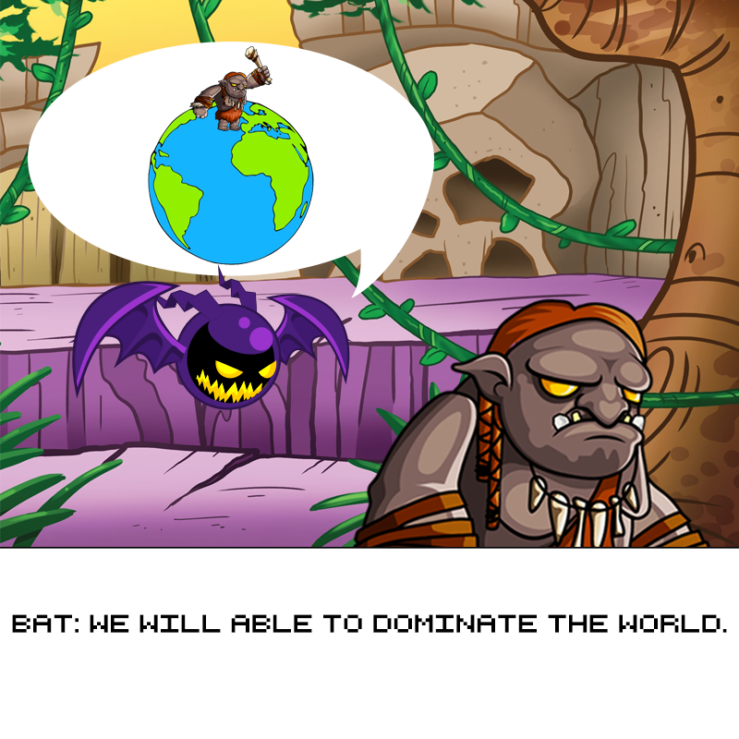
Gameplay
Overview

Slide 11
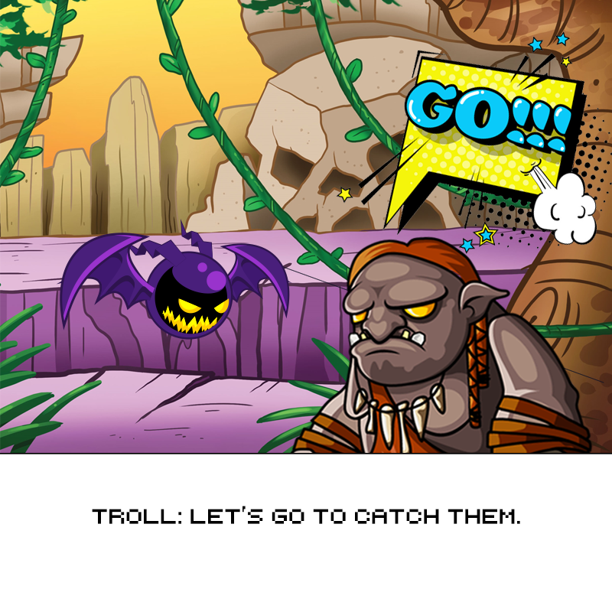
Gameplay
Overview

Slide 12
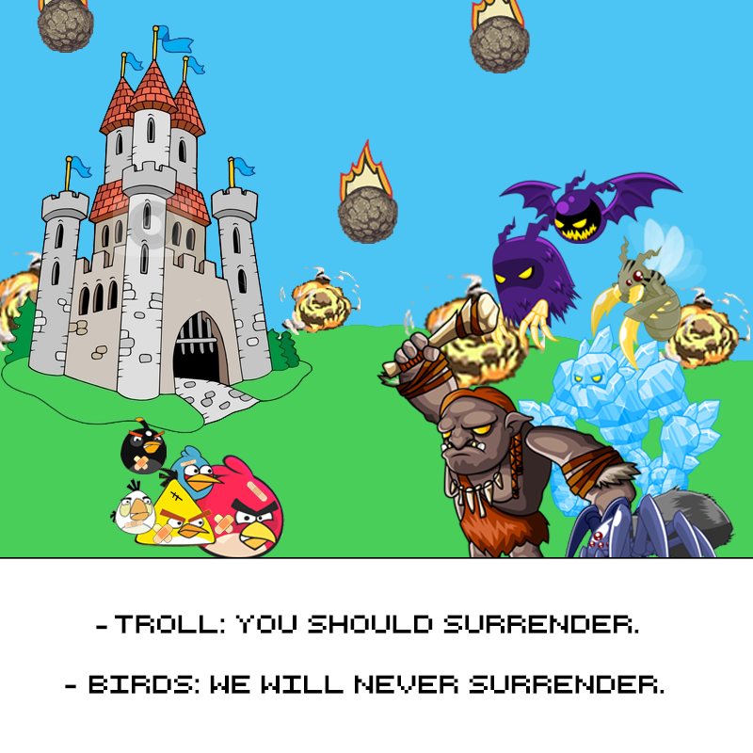
Gameplay
Overview

Slide 13
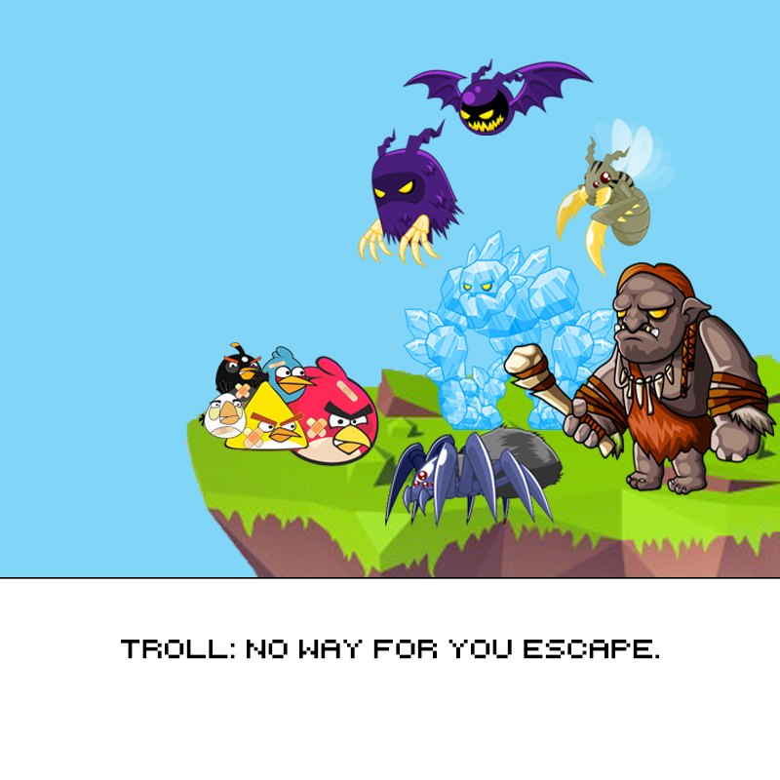
Gameplay
Overview

Slide 14
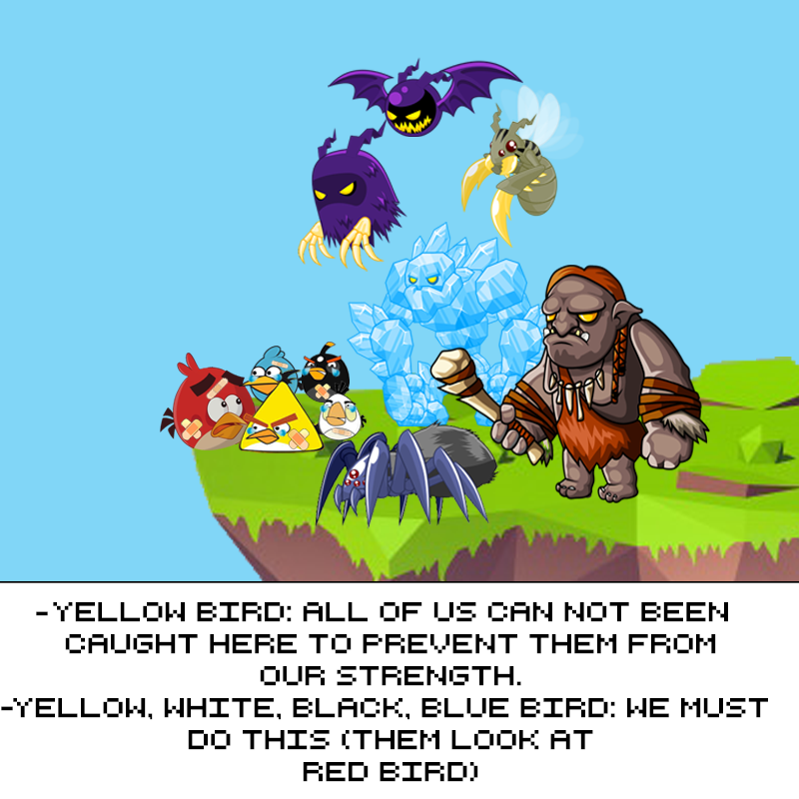
Gameplay
Overview

Slide 15
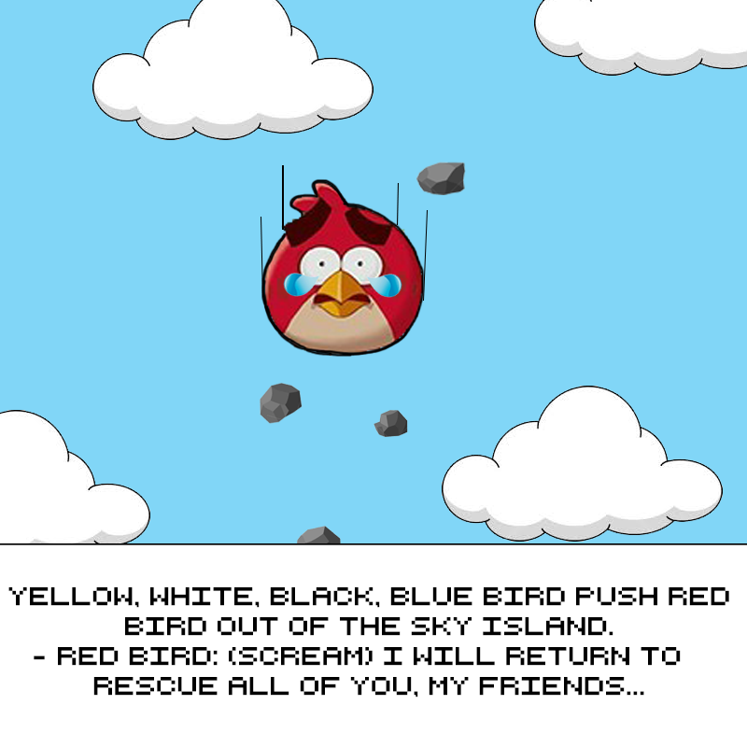
Gameplay
Overview

Slide 16
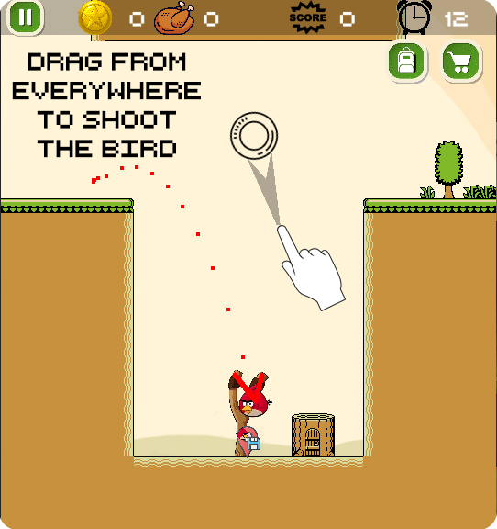
Gameplay
Control
Drag from anywhere on the screen to get desired direction and then drop to launch the bird

Slide 17
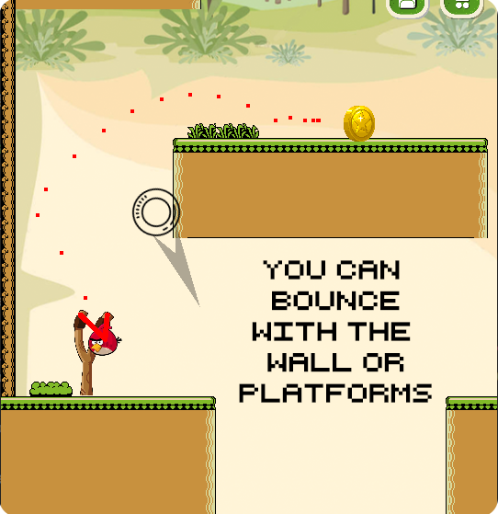
Gameplay
Control
Use left right button to move the bird on plataforms

Slide 18
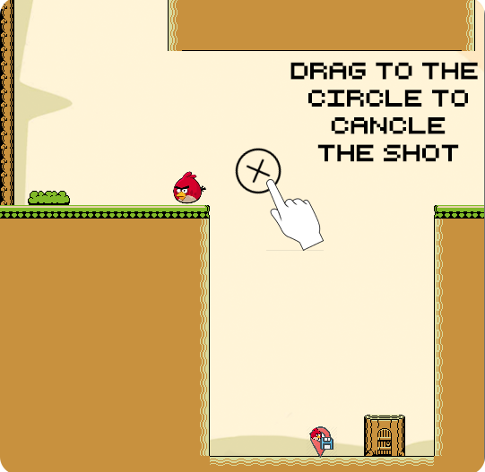
Gameplay
Control
Drag to circle to cancel the current action

Slide 19

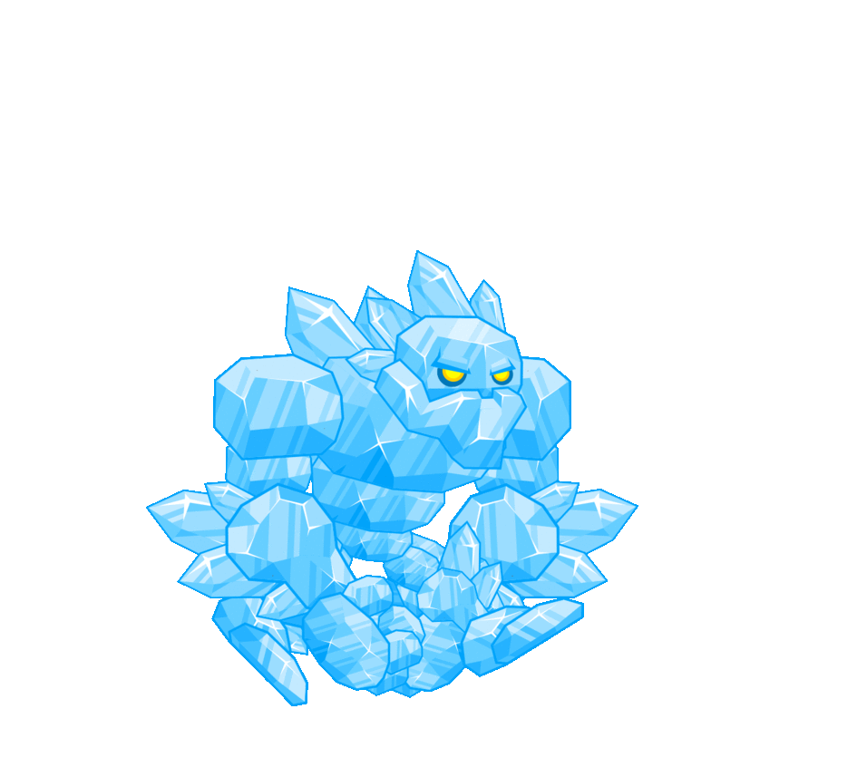
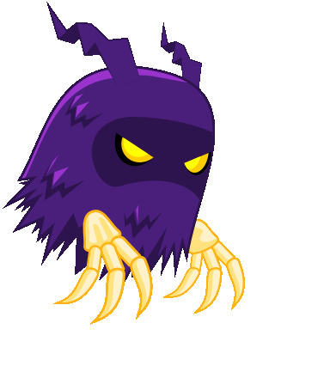

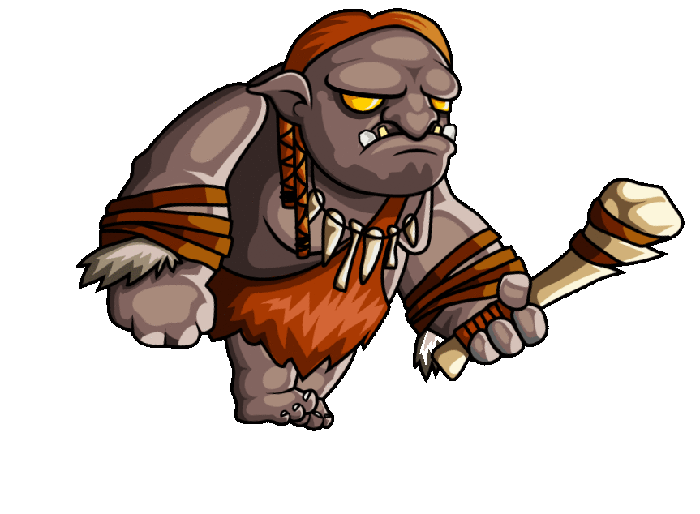
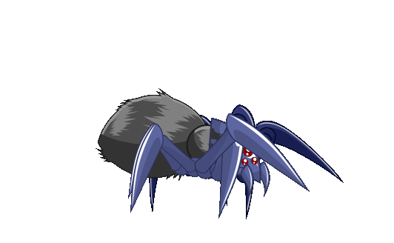
Gameplay
Enemies

Slide 20




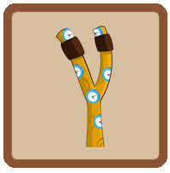

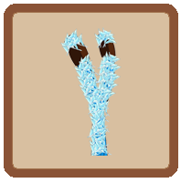

Gameplay
items

Slide 21
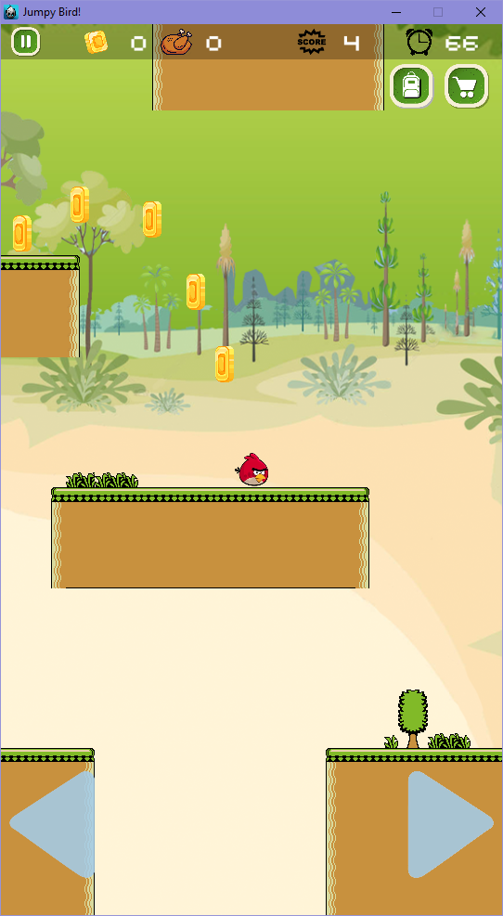
Gameplay
environments
Waste land

Slide 22
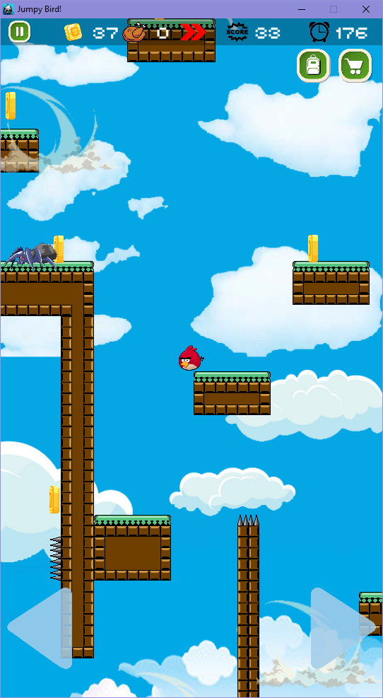
Gameplay
environments
Windy land

Slide 23
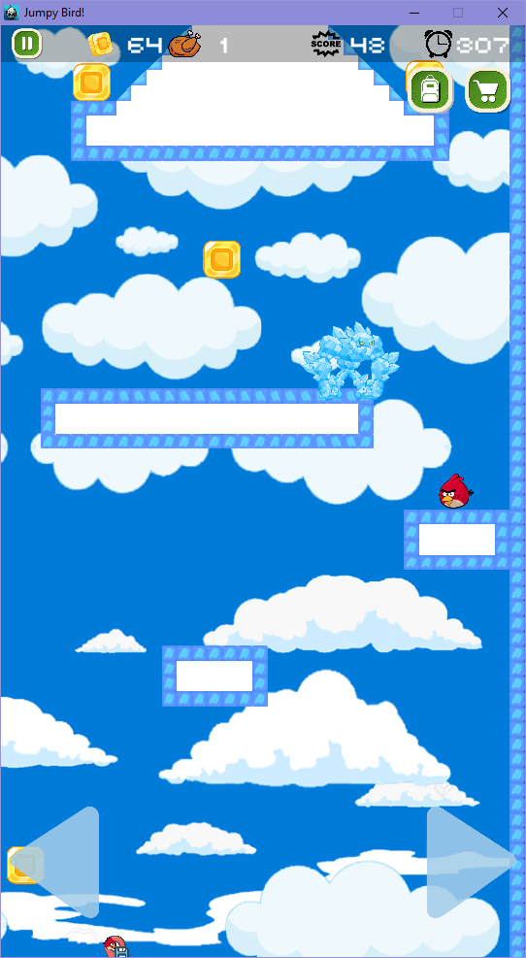
Gameplay
environments
Icy land

Slide 24
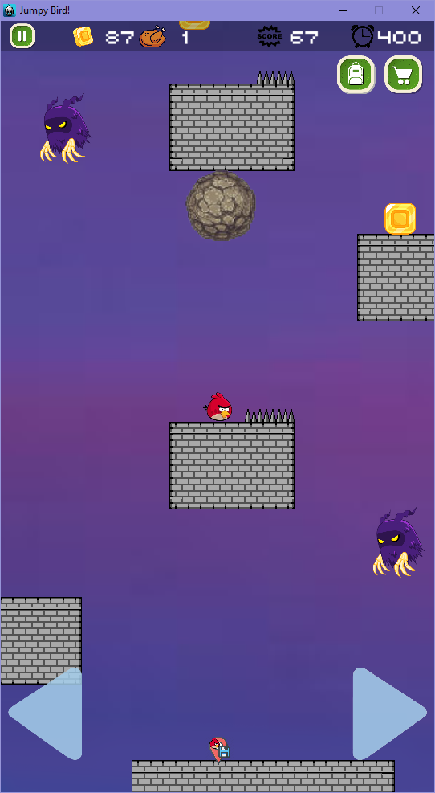
Gameplay
environments
Fairy
castle

Slide 25
Development
Tools of the trade
Achievements
Difficulties
Futur orientation

Slide 26








Development
Tools of the trade

Slide 27

Development
Achievements
Basic/advanced C++ programming
Game design patterns
Cocos2Dx knowledge + Box2D
GIT

Slide 28

Development
Achievements
Game porting
particle effect, UI, etc.
Basic game designing skills

Slide 29

Development
Difficulties
Documentations
Physics issues

Slide 30
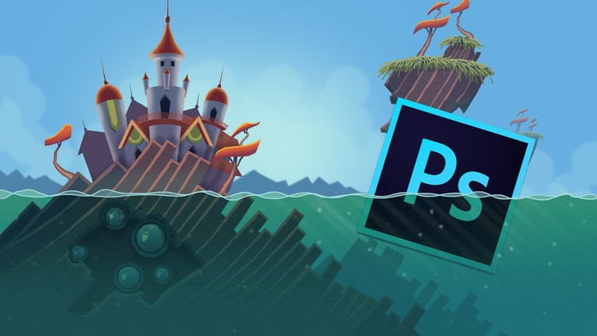
Development
Difficulties
Tools
Asset creation
Design a interesting level
Balancing

Slide 31

Development
Future orientation
Horizontal maps
More monsters with different behaviors
More weapons
More environments
Destructible platforms

Slide 32
Thank you for listening

Slide 33


